Slide 1

How-To: Game Theory
Timea Balogh
University of California, Davis

Slide 2
The following slides cover…
Game Theory: Prisoner’s Dilemma (PD)
Game Theory: Game of Chicken & Battle of the Sexes
Today, we will practice:
Solving games using best response analysis
Identifying different types of games based on equilibria (PD, Chicken, Battle of Sexes)
Normal Form to Extensive Form Games
Solving extensive form games using backwards induction
Notes:
For the exam, you will need to know how to
Solve a game for its equlibrium/equilibria using best response analysis
Identify the type of game (PD, Chicken, Battle of Sexes) after solving them or based on their solutions
We will walk through how to do both of these things today!

Slide 3
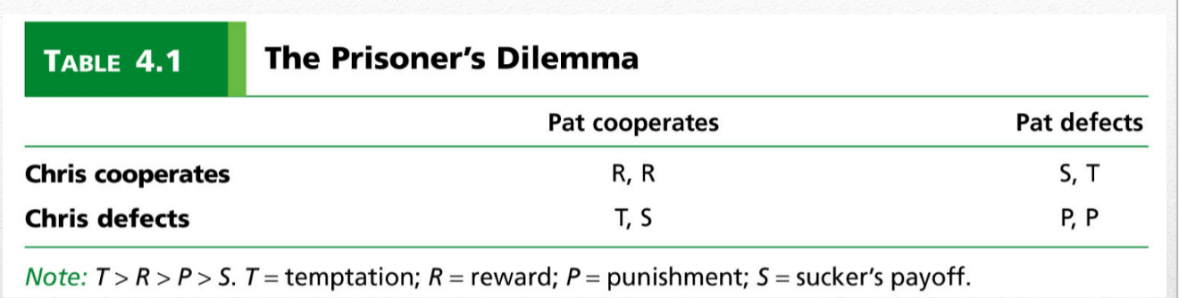
The Prisoner’s Dilemma (PD) Game
Players: 2 (P1 and P2)
Strategies for each player: Cooperate (C) or Defect (D)
Payoffs: Depicted in each square of a 2x2 game
P1/row player→ first number in payoff box
P2/column player → second number in payoff box
In this example…payoff ranking is: T>R>P>S
P2 = column player = 2nd number
P1
=row player = 1st number
C
D
C
D

Slide 4
Prisoner’s Dilemma has 4 Possible Outcomes
If both prisoners cooperate (C,C)
Both get 1 year in prison
If both prisoners defect (D,D)
Both get 10 years in prison
If Prisoner 1 cooperates, while Prisoner 2 defects (C,D)
P1 gets 25 years in prison, while P2 goes free
If Prisoner 1 defects, while Prisoner 2 cooperates (D,C)
P1 goes free, while P2 gets 25 years in prison
Notes:
In the Prisoner’s Dilemma, there are 2 players (Prisoner 1 and Prisoner 2)
Each player has two strategies at their disposal → can cooperate C or defect D
Each “outcome” consists of Player 1 taking some action (C or D) and Player 2 taking some action (C or D)

Slide 5
How does each player rank the outcomes?
Key interest for each player is to get the shortest possible prison sentence
Going free>1 yr in prison>10 yrs in prison>25 yrs in prison
Let’s rank their outcomes:
P1: Temptation (D,C) > Reward (C,C) > Punishment (D,D) > Sucker (C,D)
P2: Temptation (C,D) > Reward (C,C) > Punishment (D,D) > Sucker (D,C)
Jail sentence + Payoffs (ranked from most (4) to least desirable (1)) | Which outcome produces that sentence for Prisoner 1? | Which outcome produces that sentence for Prisoner 2?
4 = Go free = TEMPTATION | D,C | C,D
3 = 1 year jail = REWARD | C,C | C,C
2 = 10 years jail = PUNISHMENT | D,D | D,D
1 = 25 years jail = SUCKER | C,D | D,C
Notes:
As the amount of time in jail increases, the payoffs decrease in value. Therefore, going free provides the greatest possible payoff (4) because it is most preferred and getting 25 years of jail time gets the least possible payoff (1) because it is least preferred.
Remember the payoff notation:
D,C indicates that P1 plays D and P2 plays C (b/c P1 is always the first value, and P2 is always the second value)
Similarly, C,D indicates that P1 plays C and P2 plays D
In words, P1 is best off when they defect and the other player cooperates (because then they go free) and is worse off when they cooperate and the other defects (then the other player goes free while you go to prison for 25 years)
Also, P1 would prefer to mutually cooperate (achieving only 1 year jail time) over mutually defecting (achieving significantly more, 10 years in jail)
P2 has the same preferences. P2 is best off when they defect and the other player cooperates (bc then they go free) and is worse off when they cooperate but the other player defects (bc then they get 25 years in prison and the other player goes free). P2 also would rather mutually cooperate (CC) and get 1 year in prison each than mutually defect (DD) and get 10 years in prison each.
THE SUCKER PAYOFF IS YOUR WORST CASE SCENARIO WHERE YOU COOPERATE BUT YOUR PARTNER DEFECTS SO YOU GET THROWN IN JAIL FOR 25 YEARS, BUT THEY ROAM FREE
THE TEMPTATION PAYOFF IS YOUR BEST CASE SCENARIO WHERE YOU DEFECT WHILE YOUR PARTNER COOPERATES SO THEY GET THROWN IN JAIL FOR 25 YEARS, BUT YOU GET TO ROAM FREE

Slide 6
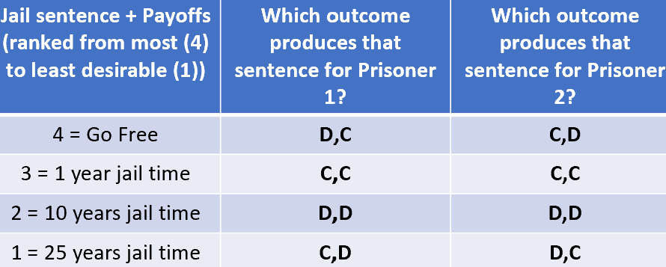
Setting up the “game”...
Player 2
 | C (Cooperate) | D (Defect)
C (Cooperate)
D (Defect)
Player 1
Notes:
Let’s start with C,C → the top left quadrant
What values are associated with C,C for player 1?
Player 1: This is their second best option → they get 3
Let’s add this to the game box

Slide 7
Setting up the “game”...
Player 2
 | C (Cooperate) | D (Defect)
C (Cooperate) | 3,
D (Defect)
Player 1
Notes:
Let’s start with C,C → the top left quadrant
What payoff is associated with C,C for player 1?
Player 1: This is their second best option → they get 3
Let’s add this to the game box
THIS IS THE REWARD PAYOFF (3) for player 1

Slide 8
Setting up the “game”...
Player 2
 | C (Cooperate) | D (Defect)
C (Cooperate) | 3, 3
D (Defect)
Player 1
Notes:
Let’s start with C,C → the top left quadrant
What payoff is associated with C,C for player 2?
Player 2: This is also their second best option → they get 3
Let’s add this to the game box
THIS IS THE REWARD PAYOFF (3) for player 1

Slide 9
Setting up the “game”...
Player 2
 | C (Cooperate) | D (Defect)
C (Cooperate) | 3, 3
D (Defect)
Player 1
Notes:
Now let’s fill in the top right box, where Player 1 cooperates and Player 2 defects (C,D)

Slide 10
Setting up the “game”...
Player 2
 | C (Cooperate) | D (Defect)
C (Cooperate) | 3, 3 | 1,
D (Defect)
Player 1
Notes:
Now let’s fill in the top right box, where Player 1 cooperates and Player 2 defects (C,D)
What payoff is associated with C,D for Player 1, where they cooperate but player 2 defects
For player 1, this is the worst case scenario; it is the least preferred option. They end up getting 25 years prison and the other goes free.
So for Player 1, this gives them a payoff of only 1 as per our table of the ranked outcomes.
SUCKER PAYOFF (1)

Slide 11
Setting up the “game”...
Player 2
 | C (Cooperate) | D (Defect)
C (Cooperate) | 3, 3 | 1, 4
D (Defect)
Player 1
Notes:
Now let’s fill in the top right box, where Player 1 cooperates and Player 2 defects (C,D)
What payoff is associated with C,D for Player 2, where defect but player 1 has cooperated?
For player 2, this is the BEST case scenario. They get to go free with no time in prison and the other player takes 25 years in prison.
So they get a payoff of 4 from this outcome.
TEMPTATION PAYOFF (4)

Slide 12
Setting up the “game”...
Player 2
 | C (Cooperate) | D (Defect)
C (Cooperate) | 3, 3 | 1, 4
D (Defect)
Player 1
Notes:
Now let’s fill in the top right box, where Player 1 defects and Player 2 cooperates (D,C)
What payoff is associated with C,D for Player 1?
This is the opposite of the previous situation where Player 1 cooperated while Player 2 defected. In this case, Player 1 is defecting while the other player cooperates.
For player 1, this is their best case scenario because they get to avoid going to prison and player 2 gets 25 years.
Based on the ranking of outcomes chart, we assign a payoff of 4 to player 1 for D,C
TEMPTATION PAYOFF (4)
What payoff is associated with C,D for Player 2?
Like Player 1 in the last example, Player 2 is now the “sucker”. They cooperated when the other player defected, so they end up in prison for 25 years while the other roams free.
For player 2, this is the worst case scenario and so they get a payoff of 1.
SUCKER PAYOFF (1)

Slide 13
Setting up the “game”...
Player 2
 | C (Cooperate) | D (Defect)
C (Cooperate) | 3, 3 | 1, 4
D (Defect) | 4, 1
Player 1
Notes:
Now let’s fill in the top right box, where Player 1 defects and Player 2 cooperates (D,C)
What payoff is associated with C,D for Player 1?
This is the opposite of the previous situation where Player 1 cooperated while Player 2 defected. In this case, Player 1 is defecting while the other player cooperates.
For player 1, this is their best case scenario because they get to avoid going to prison and player 2 gets 25 years.
Based on the ranking of outcomes chart, we assign a payoff of 4 to player 1 for D,C
This is the TEMPTATION payoff (4)
What payoff is associated with C,D for Player 2?
Like Player 1 in the last example, Player 2 is now the “sucker”. They cooperated when the other player defected, so they end up in prison for 25 years while the other roams free.
For player 2, this is the worst case scenario and so they get a payoff of 1.
This is the SUCKER payoff (1)

Slide 14
Setting up the “game”...
Player 2
 | C (Cooperate) | D (Defect)
C (Cooperate) | 3, 3 | 1, 4
D (Defect) | 4, 1
Player 1
Notes:
Finally, let’s fill in the bottom right box, where both players defect. If both defect, they each get 10 years in prison.
What are the players’ payoffs for the outcome of D,D?
10 years of prison is not as bad as 25, but it isn’t as good as just 1 or even less good than getting 0/going free, so this is both players’ second worst outcome.
Based on the ranked outcomes chart we created, each gets a payoff of 2 for this outcome
This is the PUNISHMENT payoff (2) for both players

Slide 15
Setting up the “game”...
Player 2
 | C (Cooperate) | D (Defect)
C (Cooperate) | 3, 3 | 1, 4
D (Defect) | 4, 1 | 2, 2
Player 1
Notes:
Finally, let’s fill in the bottom right box, where both players defect. If both defect, they each get 10 years in prison.
What are the players’ payoffs for the outcome of D,D?
10 years of prison is not as bad as 25, but it isn’t as good as just 1 or even less good than getting 0/going free, so this is both players’ second worst outcome.
Based on the ranked outcomes chart we created, each gets a payoff of 2 for this outcome
This is the PUNISHMENT PAYOFF (2) for both players

Slide 16
The final game set up
Player 2
 | C (Cooperate) | D (Defect)
C (Cooperate) | 3, 3 Reward, Reward | 1, 4 Sucker, Temptation
D (Defect) | 4, 1 Temptation, Sucker | 2, 2 Punishment, Punishment
Player 1
1 = Sucker
2 = Punishment
3 = Reward
4 = Temptation
Remember:
4>3>2>1 so…
Temptation > Reward > Punishment > Sucker
Notes:
When we’re all done, we get the following game.
Moving forward you will start with something like this and then have to “solve” the game for its equilibrium. But it’s important to know the logic behind where these values and ranked preferences come from!
It also helps show how player 1 will be the first number in each box and player 2 will be the second number in each box, which you need to know for solving games.
In terms of notation, the first number will always correspond to Player 1 and the second number will always correspond to Player 2

Slide 17
How do we “solve” a normal-form game?
“Solving” a game means finding its Nash Equilibrium(s)
Nash Equilibrium → A combination of strategies of all players (e.g. P1 picks C or D and P2 picks C or D) in which no player has incentive to unilaterally change its behavior, given what they expect the other player to do.
To find the Nash Equilibrium (NE), we use Best Response Analysis
If Player 1 plays __ (C or D), what should Player 2 do (play C or D)?
If Player 2 plays __ (C or D), what should Player 1 do (play C or D)?

Slide 18
Let’s “solve” the PD game we set up earlier using best response analysis
Player 2
 | C (Cooperate) | D (Defect)
C (Cooperate) | 3, 3 | 1, 4
D (Defect) | 4, 1 | 2, 2
Player 1

Slide 19
Let’s “solve” the PD game we set up earlier using “best response analysis”
Player 2
 | C (Cooperate) | D (Defect)
C (Cooperate) | 3, 3 | 1, 4
D (Defect) | 4, 1 | 2, 2
Ask yourself…if P2 cooperates, what would P1 want to do?
Player 1
Notes:
Tip: Put yourself in P1s shoes; if you were them, which outcome/payoff would you prefer given what P2 did?
Here, P1 is picking between cooperating also and getting 3, or defecting and getting 4.
So if you were P1, which would you rather pick….Cooperate and get 3, or Defect and get 4?
Answer: You’d choose Defect (D) b/c 4>3

Slide 20
Let’s “solve” the PD game...(“best response analysis”)
Player 2
 | C (Cooperate) | D (Defect)
C (Cooperate) | 3, 3 | 1, 4
D (Defect) | 4* 1 | 2, 2
If P2 cooperates, P1 will want to defect (4>3)
Player 1
Notes:
Tip: Put yourself in P1s shoes; if you were them, which outcome/payoff would you prefer given what P2 did?
Here, P1 is picking between cooperating also and getting 3, or defecting and getting 4.
So if you were P1, which would you rather pick….Cooperate and get 3, or Defect and get 4?
Answer: You’d choose Defect (D) b/c 4>3

Slide 21
Let’s “solve” the PD game...(“best response analysis”)
Player 2
 | C (Cooperate) | D (Defect)
C (Cooperate) | 3, 3 | 1, 4
D (Defect) | 4*, 1 | 2, 2
If P2 defects, what would P1 want to do?
Player 1
Notes:
Tip: Put yourself in P1s shoes; if you were them, which outcome/payoff would you prefer given what P2 did?
Here, P1 is picking between cooperating and getting 1, or defecting and getting 2.
So if you were P1, which would you rather pick….Cooperate and get 1, or Defect and get 2?
Answer: You’d choose Defect (D) b/c 2>1

Slide 22
Let’s “solve” the PD game...(“best response analysis”)
Player 2
 | C (Cooperate) | D (Defect)
C (Cooperate) | 3, 3 | 1, 4
D (Defect) | 4*, 1 | 2*, 2
If P2 defects, P1 will want to defect (2>1)
Player 1
Notes:
Tip: Put yourself in P1s shoes; if you were them, which outcome/payoff would you prefer given what P2 did?
Here, P1 is picking between cooperating and getting 1, or defecting and getting 2.
So if you were P1, which would you rather pick….Cooperate and get 1, or Defect and get 2?
Answer: You’d choose Defect (D) b/c 2>1

Slide 23
Let’s “solve” the PD game...(“best response analysis”)
Player 2
 | C (Cooperate) | D (Defect)
C (Cooperate) | 3, 3 | 1, 4
D (Defect) | 4*, 1 | 2*, 2
If P1 cooperates, what would P2 want to do?
Player 1
Notes:
Tip: Now put yourself in P2s shoes: If you were P2, which outcome/payoff would you prefer given what P1 did?
Here, P2 is picking between cooperating and getting 3, or defecting and getting 4.
So if you were P2, which would you rather pick….Cooperate and get 3, or Defect and get 4?
Answer: You’d choose Defect (D) b/c 4>3

Slide 24
Let’s “solve” the PD game...(“best response analysis”)
Player 2
 | C (Cooperate) | D (Defect)
C (Cooperate) | 3, 3 | 1, 4*
D (Defect) | 4*, 1 | 2*, 2
If P1 cooperates, P2 will want to defect (4>3)
Player 1
Notes:
Tip: Now put yourself in P2s shoes: If you were P2, which outcome/payoff would you prefer given what P1 did?
Here, P2 is picking between cooperating and getting 3, or defecting and getting 4.
So if you were P2, which would you rather pick….Cooperate and get 3, or Defect and get 4?
Answer: You’d choose Defect (D) b/c 4>3

Slide 25
Let’s “solve” the PD game...(“best response analysis”)
Player 2
 | C (Cooperate) | D (Defect)
C (Cooperate) | 3, 3 | 1, 4*
D (Defect) | 4*, 1 | 2*, 2
If P1 defects, what would P2 want to do?
Player 1
Notes:
Tip: Now put yourself in P2s shoes: If you were P2, which outcome/payoff would you prefer given what P1 did?
Here, P2 is picking between cooperating and getting 1, or defecting and getting 2.
So if you were P2, which would you rather pick….Cooperate and get 1, or Defect and get 2?
Answer: You’d choose Defect (D) b/c 2>1

Slide 26
Let’s “solve” the PD game...(“best response analysis”)
Player 2
 | C (Cooperate) | D (Defect)
C (Cooperate) | 3, 3 | 1, 4*
D (Defect) | 4*, 1 | 2*, 2*
If P1 defects, P2 will want to defect (2>1)
Player 1
Notes:
Tip: Now put yourself in P2s shoes: If you were P2, which outcome/payoff would you prefer given what P1 did?
Here, P2 is picking between cooperating and getting 1, or defecting and getting 2.
So if you were P2, which would you rather pick….Cooperate and get 1, or Defect and get 2?
Answer: You’d choose Defect (D) b/c 2>1

Slide 27
The “Solved” PD Game = The Equilibrium = Defect, Defect → If it has 2 asterisks, then it is an equilibria!
Player 2
 | C (Cooperate) | D (Defect)
C (Cooperate) | 3, 3 | 1, 4*
D (Defect) | 4*, 1 | 2*, 2*
Player 1
Notes:
If P1 cooperates, P2 wants to defect (see star on C,D, payoff 4)
If P1 defects, P2 wants to defect (see star on D,D, payoff 2)
If P2 cooperates, P1 wants to defect (see star on D,C, payoff 4)
If P2 defects, P1 wants to defect (see star on D,D, payoff 2)
**The dominant strategy for each player is to defect (dominant strategy means it is always the best option for the player to defect, even though they would be better off mutually cooperating (CC gives them 3 each, while DD only gives them 2 each, and 3>2)
But then why do we end up at the suboptimal outcome of mutual defection. AKA, why do we end up at D,D and not C,C?
Because of incentives to defect!!!
It is called a Prisoner’s “Dilemma” because both players would be better off at C,C (get 3 each) than D,D (get 2 each), but there is incentive to defect and get 4, so we end up at D,D rather than C,C. No player would want to STAY at C,C because they’d be better off/are incentivized to defect and get 4 (D,C or C,D yields a payoff of 4 to P1 and P2, respectively)
Unfortunately, defecting while the other cooperates gives each player the maximum payoff and this creates the incentive to defect. This is why C,D for player 2 and D,C for player 1 is called the “Temptation” outcome

Slide 28
The “Solved” PD Game = The Equilibrium = Defect, Defect → If it has 2 asterisks, then it is an equilibria!
Player 2
 | C (Cooperate) | D (Defect)
C (Cooperate) | 3, 3 | 1, 4*
D (Defect) | 4*, 1 | 2*, 2*
Can you explain why this is considered a “Nash equilibrium”?
Hint: Does either player have incentive to unilaterally change their behavior?
Player 1
Notes:
At this equilibrium, both players are defecting. Let’s pretend we are player 2.
If player 1 decides to unilaterally cooperate instead of defect (keeping player 2 the same), they end up with 1 instead of 2, so they are worse off. They don’t want to do this rationally!
If player 2 decides to cooperate instead of defect (keeping player 1 the same) they also are worse off because they end up with 1 rather than 2, so they also don’t want to do this rationally.
Neither player has incentive to unilaterally change their behavior, making this a Nash Equilibrium.
However, despite being a N.E., Defect, Defect is NOT pareto optimal. Both players would be better off mutually cooperating (C,C) because they would each get 3 instead of 2, which is an improvement. However, due to the temptation payoff and incentive to defect due to it, neither player can TRUST that the other will cooperate along with them.
This is why this is called a “dilemma” → both players are better off cooperating with each other, but due to mistrust and incentive to defect, they both end up worse off than they could be and both defect.

Slide 29
What about other types of games?
The Prisoner’s Dilemma (PD) is just one possible 2x2, normal-form game, which so happens to have ONE equilibrium (D,D/defect, defect)
But there are other games, some with multiple equilibria
Solving other games is just like solving the PD → use best response analysis to find the equilibrium!
Let’s practice solving a different game….

Slide 30
Steps to Solve a Normal-Form Game
Step 1 - Solve the game for its equilibrium(s) using best response analysis
1
Step 2 - Determine what “type” of game it is
2
Prisoner’s Dilemma (PD)
Game of Chicken
Battle of Sexes
Notes:
Solving a game for its equilibria and identifying what type of game it is is something you will very likely will be expected to do for the exam, so let’s practice this

Slide 31
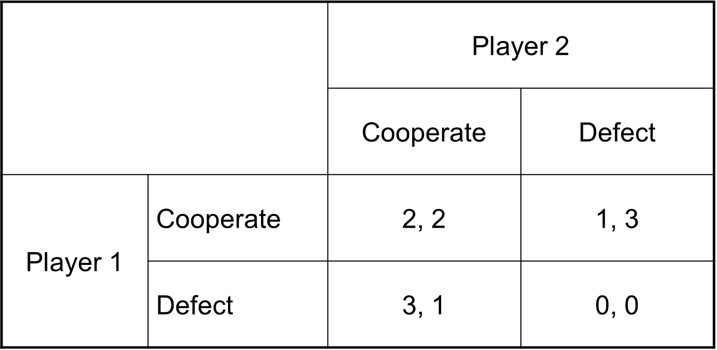
Let’s solve this game using “best response analysis”
If P2 cooperates (C), what does P1 want to do?
Notes:
Given that P2 has cooperated, P1 must decide whether to cooperate or defect. Here is how you decide:
Tip: Imagine you are P1 (put yourself in P1s shoes)
Step 1 – Restrict your viewing to only the cooperate column (since this is what P2 selected); completely ignore the defect column b/c that is not what P2 chose
Step 2 – Now, in that cooperate column, focus only on the first of the two numbers (these are P1s payoffs)
Step 3 – Compare the payoffs that P1 would get from choosing to also cooperate, or choosing to defect (in this case, P1 gets 2 if they cooperate, and 3 if they defect)
Step 4 – Determine which strategy gives P1 the highest payoff and circle or star that choice
Answer: *In this case, a payoff of 3 (from defecting) is greater than a payoff of 2 (from cooperating), so P1 will choose to DEFECT

Slide 32
Let’s solve this game using “best response analysis”
If P2 cooperates (C), what does P1 want to do?
*
Notes:
Given that P2 has cooperated, P1 must decide whether to cooperate or defect. Here is how you decide:
Tip: Imagine you are P1 (put yourself in P1s shoes)
Step 1 – Restrict your viewing to only the cooperate column (since this is what P2 selected); completely ignore the defect column b/c that is not what P2 chose
Step 2 – Now, in that cooperate column, focus only on the first of the two numbers (these are P1s payoffs)
Step 3 – Compare the payoffs that P1 would get from choosing to also cooperate, or choosing to defect (in this case, P1 gets 2 if they cooperate, and 3 if they defect)
Step 4 – Determine which strategy gives P1 the highest payoff and circle or star that choice
Answer: *In this case, a payoff of 3 (from defecting) is greater than a payoff of 2 (from cooperating), so P1 will choose to DEFECT

Slide 33
Let’s solve this game using “best response analysis”
If P2 defects (D), what does P1 want to do?
*
Notes:
Given that P2 has defected, P1 must decide whether to cooperate or defect. Here is how you decide:
Tip: Imagine you are P1 (put yourself in P1s shoes)
Step 1 – Restrict your viewing to only the defect column (since this is what P2 selected); completely ignore the cooperate column b/c that is not what P2 chose
Step 2 – Now, in that defect column, focus only on the first of the two numbers (these are P1s payoffs)
Step 3 – Compare the payoffs that P1 would get from choosing to also defect, or choosing to cooperate (in this case, P1 gets 1 if they cooperate, and 0 if they defect)
Step 4 – Determine which strategy gives P1 the highest payoff and circle or star that choice
Answer: *In this case, a payoff of 1 (from cooperating) is greater than a payoff of 0 (from defecting), so P1 will choose to COOPERATE

Slide 34
Let’s solve this game using “best response analysis”
If P2 defects (D), what does P1 want to do?
*
*
Notes:
Given that P2 has defected, P1 must decide whether to cooperate or defect. Here is how you decide:
Tip: Imagine you are P1 (put yourself in P1s shoes)
Step 1 – Restrict your viewing to only the defect column (since this is what P2 selected); completely ignore the cooperate column b/c that is not what P2 chose
Step 2 – Now, in that defect column, focus only on the first of the two numbers (these are P1s payoffs)
Step 3 – Compare the payoffs that P1 would get from choosing to also defect, or choosing to cooperate (in this case, P1 gets 1 if they cooperate, and 0 if they defect)
Step 4 – Determine which strategy gives P1 the highest payoff and circle or star that choice
Answer: *In this case, a payoff of 1 (from cooperating) is greater than a payoff of 0 (from defecting), so P1 will choose to COOPERATE

Slide 35
Let’s solve this game using “best response analysis”
If P1 cooperates (C), what does P2 want to do?
*
*
Notes:
Given that P1 has cooperated, P2 must decide whether to cooperate or defect. Here is how you decide:
Tip: Imagine you are P2 (put yourself in P2s shoes)
Step 1 – Restrict your viewing to only the cooperate row (since this is what P1 selected); completely ignore the defect row b/c that is not what P1 chose
Step 2 – Now, in that cooperate row, focus only on the second of the two numbers (these are P2s payoffs)
Step 3 – Compare the payoffs that P2 would get from choosing to also cooperate, or choosing to defect (in this case, P2 gets 2 if they cooperate, and 1 if they defect)
Step 4 – Determine which strategy gives P2 the highest payoff and circle or star that choice
Answer: *In this case, a payoff of 3 (from defecting) is greater than a payoff of 2 (from cooperating), so P2 will choose to DEFECT

Slide 36
Let’s solve this game using “best response analysis”
If P1 cooperates (C), what does P2 want to do?
*
*
*
Notes:
Given that P1 has cooperated, P2 must decide whether to cooperate or defect. Here is how you decide:
Tip: Imagine you are P2 (put yourself in P2s shoes)
Step 1 – Restrict your viewing to only the cooperate row (since this is what P1 selected); completely ignore the defect row b/c that is not what P1 chose
Step 2 – Now, in that cooperate row, focus only on the second of the two numbers (these are P2s payoffs)
Step 3 – Compare the payoffs that P2 would get from choosing to also cooperate, or choosing to defect (in this case, P2 gets 2 if they cooperate, and 1 if they defect)
Step 4 – Determine which strategy gives P2 the highest payoff and circle or star that choice
Answer: *In this case, a payoff of 3 (from defecting) is greater than a payoff of 2 (from cooperating), so P2 will choose to DEFECT

Slide 37
Let’s solve this game using “best response analysis”
If P1 defects (D), what does P2 want to do?
*
*
*
Notes:
Given that P1 has defected, P2 must decide whether to cooperate or defect. Here is how you decide:
Tip: Imagine you are P2 (put yourself in P2s shoes)
Step 1 – Restrict your viewing to only the defect row (since this is what P1 selected); completely ignore the cooperate row b/c that is not what P1 chose
Step 2 – Now, in that defect row, focus only on the second of the two numbers (these are P2s payoffs)
Step 3 – Compare the payoffs that P2 would get from choosing to also defect, or choosing to cooperate (in this case, P2 gets 1 if they cooperate, and 0 if they defect)
Step 4 – Determine which strategy gives P2 the highest payoff and circle or star that choice
Answer: *In this case, a payoff of 1 (from cooperating) is greater than a payoff of 0 (from defecting), so P2 will choose to COOPERATE

Slide 38
Let’s solve this game using “best response analysis”
If P1 defects (D), what does P2 want to do?
*
*
*
*
Notes:
Given that P1 has defected, P2 must decide whether to cooperate or defect. Here is how you decide:
Tip: Imagine you are P2 (put yourself in P2s shoes)
Step 1 – Restrict your viewing to only the defect row (since this is what P1 selected); completely ignore the cooperate row b/c that is not what P1 chose
Step 2 – Now, in that defect row, focus only on the second of the two numbers (these are P2s payoffs)
Step 3 – Compare the payoffs that P2 would get from choosing to also defect, or choosing to cooperate (in this case, P2 gets 1 if they cooperate, and 0 if they defect)
Step 4 – Determine which strategy gives P2 the highest payoff and circle or star that choice
Answer: *In this case, a payoff of 1 (from cooperating) is greater than a payoff of 0 (from defecting), so P2 will choose to COOPERATE

Slide 39
Putting it all together, we have two equilibria: (C,D) and (D,C)
What type of game is this? Why?
Prisoner’s Dilemma?
Battle of the Sexes?
Chicken?
 |  | Player 2
 |  | Cooperate | Defect
Player 1 | Cooperate | 2, 2 | 1*, 3*
 | Defect | 3*, 1* | 0, 0
Notes:
Recall our results from the best response analysis:
For P1:
If P2 cooperates, P1 wants to defect (D,C)
If P2 defects, P1 wants to cooperate (C,D)
For P2:
If P1 cooperates, P2 wants to defect (C,D)
If P1 defects, P2 wants to cooperate (D,C)
This gives us two boxes with two stars/asterisks (in green): D,C and C,D
Equilibria: 2 (D,C and C,D)

Slide 40
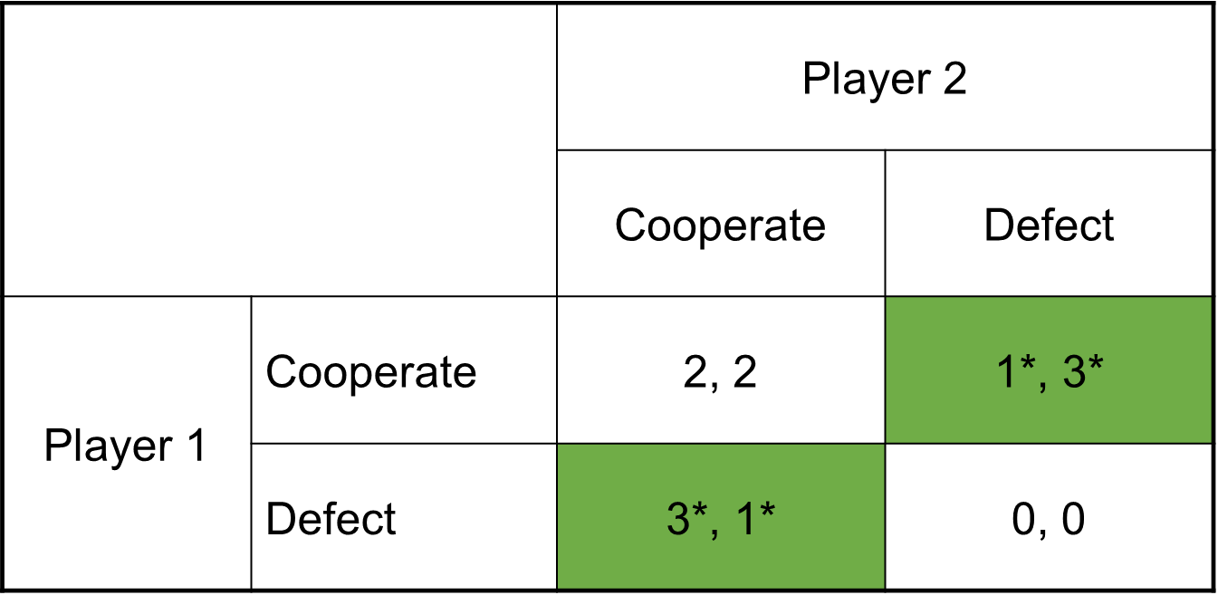
It’s a game of chicken! Chicken games have two equilibria (unlike PD which only has 1) where the two players play opposite strategies (C,D or D,C)
In the classic example, we have:
Swerve vs. Drive Straight instead of Cooperate vs. Defect
Notes:
Answer: Chicken game!
The game of Chicken models two drivers, both headed for a single lane bridge from opposite directions. The first to serve away yields the bridge to the other, but is considered the “chicken” for swerving and chickening out. If neither player swerves, they get the worst possible outcome, which is a costly deadlock or a fatal head on crash.
Each driver prefers to stay straight while the other swerves (since the other driver is the chicken, and a crash is avoided). Unlike the prisoner's dilemma, mutual defection is the worst outcome in chicken. Both players want to do the opposite of what the other player does. (So C,D and D,C are preferred over D,D or even C,C)
Sometimes called a Hawk-Dove game

Slide 41
What about the “Battle of the Sexes” game?
Unlike Chicken, BOS is a 2x2 coordination game where both players get a positive payout if they coordinate and do the same thing
Example: You and your significant other are deciding where to go out on a date. You would like to go axe throwing, while your partner would like to go see the new Antman movie. Both of you would prefer to go to the same place rather than different places (e.g. both go axe throwing or both go see Antman). Assuming you cannot communicate, what should you do?
How many equilibria? → Two ”pure strategy” equilibria
For more info: https://www.youtube.com/watch?v=2BdBWmL8tJc (Good walk through)

Slide 42
The Battle of the Sexes game looks like this and has two equilibria (where players do the same thing):
Your Partner
 | Axe Throwing | Antman movie
Axe Throwing | 2,1 | 0,0
Antman movie | 0,0 | 1,2
You
Notes:
The two equilibriums are where you coordinate and both do the same thing
e.g. axe throwing, axe throwing OR spiderman movie, spiderman movie
You don’t get utility from going to two separate places on a date on your own; you care first and foremost about going somewhere together with your partner

Slide 43

Normal Form → Extensive Form Games

Slide 44
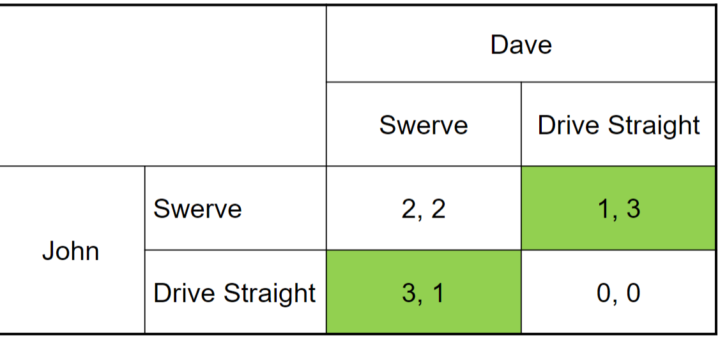
Normal-form game → Extensive-form game
In a normal-form game we assume both players move simultaneously
In extensive-form games we assume that one player moves first
Extensive form games thus give us more precise solutions
Recall John and Dave in the Game of Chicken to the right
What happens if we assume that John moves first, then followed by Dave?
Notes:
In extensive form games, order matters!
Same as practice problem

Slide 45
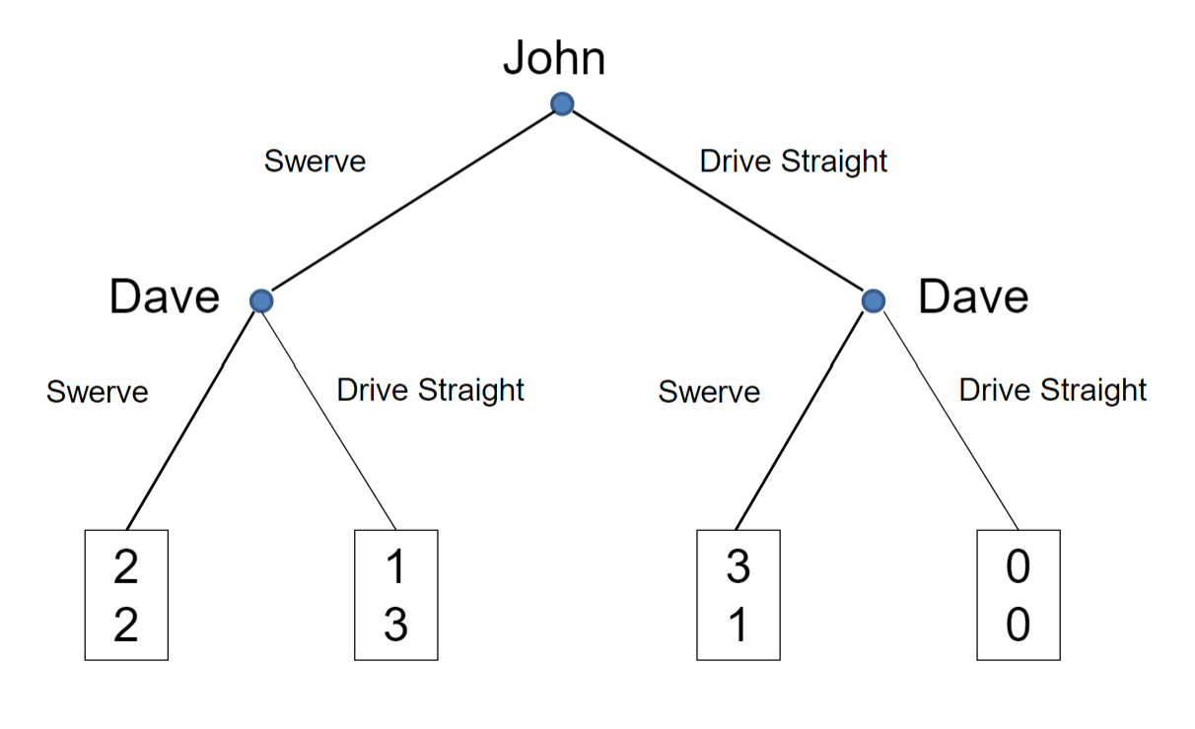
Here is the extensive form game all set up…
Notes:
In this example, John goes first. But we could redraw this with Dave going first if we wanted.

Slide 46










The Payoffs
*Remember, the top number is Player 1/first mover (AKA John) and the bottom number is Player 2/second mover (AKA Dave)
2,2: John Swerves and gets 2, Dave Swerves and gets 2
1,3: John Swerves and gets 1, Dave Drives Straight and gets 3
3,1: John Drives Straight and gets 3, Dave Swerves and gets 1
0,0: John Drives Straight and gets 0, Dave Drives Straight and gets 0
John Swerves
Dave Drives Straight
John Drives Straight
Dave Swerves
John Drives Straight
Dave Drives Straight
John Swerves
Dave Swerves
Notes:
In a normal-form game of Chicken, we get two equilibria.
In an extensive-form game, where we assume one player moves first, we end up with a single, unique equilibrium
To solve an extensive form game, you start form the bottom and work your way up. First, see what Dave would do at each of the branches.
At the left branch (which is where we end up if John swerves), Dave is choosing between Swerving (payoff = 2) and Driving Straight (payoff = 3), so Dave chooses to Drive Straight b/c 3>2.
At the right branch (which is where we end up if John drives straight), Dave is choosing between Swerving (payoff = 1) and Driving Straight (payoff = 0), so Dave chooses to Swerve b/c 1>0.
Now we know what Dave if John Swerves or John Drives Straight.
Given what Dave is going to do, what should John do?
If John Swerves, we know that Dave will Drive Straight (see above), so if John Swerves, John ends up with a payoff of 2.
If John Drives Straight, we know that Dave will Swerve (see above), so if John Drives Straight, John ends up with a payoff of 3.
Now we see which would John prefer. Does John want to Serve and get 2, or Drive Straight and get 3?
3>2, so John will choose to Drive Straight.
Thus, we end up at John Driving Straight, followed by Dave Swerving, leaving John with payoff = 3 and Dave with payoff =1.
John is better off than Dave (b/c 3>1) and this is because he got to make the first move!!

Slide 47


John Swerves, Dave Swerves
The payoffs
*Remember, the top number is Player 1/first mover, AKA John, and the bottom number is Player 2/second mover AKA Dave
2,2: John Swerves and gets 2, Dave Swerves and gets 2
1,3: John Swerves and gets 1, Dave Drives Straight and gets 3
3,1: John Drives Straight and gets 3, Dave Swerves and gets 1
0,0: John Drives Straight and gets 0, Dave Drives Straight and gets 0
John Swerves
Dave Drives Straight
John Drives Straight
Dave Swerves
John Drives Straight
Dave Drives Straight
John Swerves
Dave Swerves

Slide 48


John Swerves, Dave Drives Straight
The payoffs
*Remember, the first number is Player 1/first mover, AKA John, and the second number is Player 2/second mover AKA Dave
2,2: John Swerves and gets 2, Dave Swerves and gets 2
1,3: John Swerves and gets 1, Dave Drives Straight and gets 3
3,1: John Drives Straight and gets 3, Dave Swerves and gets 1
0,0: John Drives Straight and gets 0, Dave Drives Straight and gets 0
John Swerves
Dave Drives Straight
John Drives Straight
Dave Swerves
John Drives Straight
Dave Drives Straight
John Swerves
Dave Swerves

Slide 49



John Drives Straight, Dave Swerves
The payoffs
*Remember, the first number is Player 1/first mover, AKA John, and the second number is Player 2/second mover AKA Dave
2,2: John Swerves and gets 2, Dave Swerves and gets 2
1,3: John Swerves and gets 1, Dave Drives Straight and gets 3
3,1: John Drives Straight and gets 3, Dave Swerves and gets 1
0,0: John Drives Straight and gets 0, Dave Drives Straight and gets 0
John Swerves
Dave Drives Straight
John Drives Straight
Dave Swerves
John Drives Straight
Dave Drives Straight
John Swerves
Dave Swerves

Slide 50


John Drives Straight, Dave Drives Straight
The payoffs
*Remember, the first number is Player 1/first mover, AKA John, and the second number is Player 2/second mover AKA Dave
2,2: John Swerves and gets 2, Dave Swerves and gets 2
1,3: John Swerves and gets 1, Dave Drives Straight and gets 3
3,1: John Drives Straight and gets 3, Dave Swerves and gets 1
0,0: John Drives Straight and gets 0, Dave Drives Straight and gets 0
John Swerves
Dave Drives Straight
John Drives Straight
Dave Swerves
John Drives Straight
Dave Drives Straight
John Swerves
Dave Swerves

Slide 51
What is the equilibrium? How do we find it?
Using backward induction!!
Must ask ourselves:
If John goes first and drives straight, what will Dave do?
If John goes first and swerves, what will Dave do?
Then, given what we know Dave will do in each case, what should John do as their “best” first move?
Notes:
How to solve an extended form game
In a normal-form game of Chicken, we get two equilibria.
In an extensive-form game, where we assume one player moves first, we end up with a single, unique equilibrium
To solve an extensive form game, you start form the bottom and work your way up.
First, see what Dave would do at each of the branches.
At the left branch (which is where we end up if John swerves), Dave is choosing between Swerving (payoff = 2) and Driving Straight (payoff = 3), so Dave chooses to Drive Straight b/c 3>2.
At the right branch (which is where we end up if John drives straight), Dave is choosing between Swerving (payoff = 1) and Driving Straight (payoff = 0), so Dave chooses to Swerve b/c 1>0.
Now we know what Dave if John Swerves or John Drives Straight.
Given what Dave is going to do, what should John do?
If John Swerves, we know that Dave will Drive Straight (see above), so if John Swerves, John ends up with a payoff of 2.
If John Drives Straight, we know that Dave will Swerve (see above), so if John Drives Straight, John ends up with a payoff of 3.
Now we see which would John prefer. Does John want to Serve and get 2, or Drive Straight and get 3?
3>2, so John will choose to Drive Straight.
Thus, we end up at John Driving Straight, followed by Dave Swerving, leaving John with payoff = 3 and Dave with payoff =1.
John is better off than Dave (b/c 3>1) and this is because he got to make the first move!!

Slide 52



If John goes first and drives straight, what should Dave do?
Given that John Drives Straight...
If Dave Swerves, Dave gets 1.
If Dave Drives Straight, Dave gets 0.
What should Dave do?
Notes:
How to solve an extended form game
In a normal-form game of Chicken, we get two equilibria.
In an extensive-form game, where we assume one player moves first, we end up with a single, unique equilibrium
To solve an extensive form game, you start form the bottom and work your way up. First, see what Dave would do at each of the branches.
At the left branch (which is where we end up if John swerves), Dave is choosing between Swerving (payoff = 2) and Driving Straight (payoff = 3), so Dave chooses to Drive Straight b/c 3>2.
At the right branch (which is where we end up if John drives straight), Dave is choosing between Swerving (payoff = 1) and Driving Straight (payoff = 0), so Dave chooses to Swerve b/c 1>0.
Now we know what Dave if John Swerves or John Drives Straight.
Given what Dave is going to do, what should John do?
If John Swerves, we know that Dave will Drive Straight (see above), so if John Swerves, John ends up with a payoff of 2.
If John Drives Straight, we know that Dave will Swerve (see above), so if John Drives Straight, John ends up with a payoff of 3.
Now we see which would John prefer. Does John want to Serve and get 2, or Drive Straight and get 3?
3>2, so John will choose to Drive Straight.
Thus, we end up at John Driving Straight, followed by Dave Swerving, leaving John with payoff = 3 and Dave with payoff =1.
John is better off than Dave (b/c 3>1) and this is because he got to make the first move!!

Slide 53





If John goes first and drives straight, what should Dave do?
Dave should Swerve b/c 1>0
Thus, Driving Straight is the dominated strategy (it is dominated by Swerving)
Notes:
How to solve an extended form game
In a normal-form game of Chicken, we get two equilibria.
In an extensive-form game, where we assume one player moves first, we end up with a single, unique equilibrium
To solve an extensive form game, you start form the bottom and work your way up. First, see what Dave would do at each of the branches.
At the left branch (which is where we end up if John swerves), Dave is choosing between Swerving (payoff = 2) and Driving Straight (payoff = 3), so Dave chooses to Drive Straight b/c 3>2.
At the right branch (which is where we end up if John drives straight), Dave is choosing between Swerving (payoff = 1) and Driving Straight (payoff = 0), so Dave chooses to Swerve b/c 1>0.
Now we know what Dave if John Swerves or John Drives Straight.
Given what Dave is going to do, what should John do?
If John Swerves, we know that Dave will Drive Straight (see above), so if John Swerves, John ends up with a payoff of 2.
If John Drives Straight, we know that Dave will Swerve (see above), so if John Drives Straight, John ends up with a payoff of 3.
Now we see which would John prefer. Does John want to Serve and get 2, or Drive Straight and get 3?
3>2, so John will choose to Drive Straight.
Thus, we end up at John Driving Straight, followed by Dave Swerving, leaving John with payoff = 3 and Dave with payoff =1.
John is better off than Dave (b/c 3>1) and this is because he got to make the first move!!

Slide 54



If John goes first and Swerves, what should Dave do?
Given that John Swerves…
If Dave Swerves, Dave gets 2.
If Dave Drives Straight, Dave gets 3.
What should Dave do?
Notes:
How to solve an extended form game
In a normal-form game of Chicken, we get two equilibria.
In an extensive-form game, where we assume one player moves first, we end up with a single, unique equilibrium
To solve an extensive form game, you start form the bottom and work your way up. First, see what Dave would do at each of the branches.
At the left branch (which is where we end up if John swerves), Dave is choosing between Swerving (payoff = 2) and Driving Straight (payoff = 3), so Dave chooses to Drive Straight b/c 3>2.
At the right branch (which is where we end up if John drives straight), Dave is choosing between Swerving (payoff = 1) and Driving Straight (payoff = 0), so Dave chooses to Swerve b/c 1>0.
Now we know what Dave if John Swerves or John Drives Straight.
Given what Dave is going to do, what should John do?
If John Swerves, we know that Dave will Drive Straight (see above), so if John Swerves, John ends up with a payoff of 2.
If John Drives Straight, we know that Dave will Swerve (see above), so if John Drives Straight, John ends up with a payoff of 3.
Now we see which would John prefer. Does John want to Serve and get 2, or Drive Straight and get 3?
3>2, so John will choose to Drive Straight.
Thus, we end up at John Driving Straight, followed by Dave Swerving, leaving John with payoff = 3 and Dave with payoff =1.
John is better off than Dave (b/c 3>1) and this is because he got to make the first move!!

Slide 55





If John goes first and Swerves, what should Dave do?
Dave should Drive Straight b/c 3>2
Thus, Swerving is the dominated strategy (it is dominated by Driving Straight)
Notes:
How to solve an extended form game
In a normal-form game of Chicken, we get two equilibria.
In an extensive-form game, where we assume one player moves first, we end up with a single, unique equilibrium
To solve an extensive form game, you start form the bottom and work your way up. First, see what Dave would do at each of the branches.
At the left branch (which is where we end up if John swerves), Dave is choosing between Swerving (payoff = 2) and Driving Straight (payoff = 3), so Dave chooses to Drive Straight b/c 3>2.
At the right branch (which is where we end up if John drives straight), Dave is choosing between Swerving (payoff = 1) and Driving Straight (payoff = 0), so Dave chooses to Swerve b/c 1>0.
Now we know what Dave if John Swerves or John Drives Straight.
Given what Dave is going to do, what should John do?
If John Swerves, we know that Dave will Drive Straight (see above), so if John Swerves, John ends up with a payoff of 2.
If John Drives Straight, we know that Dave will Swerve (see above), so if John Drives Straight, John ends up with a payoff of 3.
Now we see which would John prefer. Does John want to Serve and get 2, or Drive Straight and get 3?
3>2, so John will choose to Drive Straight.
Thus, we end up at John Driving Straight, followed by Dave Swerving, leaving John with payoff = 3 and Dave with payoff =1.
John is better off than Dave (b/c 3>1) and this is because he got to make the first move!!

Slide 56










Given what we know Dave will do if John Swerves or Drives Straight, what should John do?
If John Swerves, we know Dave will Drive Straight, so John gets 1.
If John Drives Straight, we know Dave will Swerve, so John gets 3.
Should John Swerve or Drive Straight?
Notes:
How to solve an extended form game
In a normal-form game of Chicken, we get two equilibria.
In an extensive-form game, where we assume one player moves first, we end up with a single, unique equilibrium
To solve an extensive form game, you start form the bottom and work your way up. First, see what Dave would do at each of the branches.
At the left branch (which is where we end up if John swerves), Dave is choosing between Swerving (payoff = 2) and Driving Straight (payoff = 3), so Dave chooses to Drive Straight b/c 3>2.
At the right branch (which is where we end up if John drives straight), Dave is choosing between Swerving (payoff = 1) and Driving Straight (payoff = 0), so Dave chooses to Swerve b/c 1>0.
Now we know what Dave if John Swerves or John Drives Straight.
Given what Dave is going to do, what should John do?
If John Swerves, we know that Dave will Drive Straight (see above), so if John Swerves, John ends up with a payoff of 2.
If John Drives Straight, we know that Dave will Swerve (see above), so if John Drives Straight, John ends up with a payoff of 3.
Now we see which would John prefer. Does John want to Serve and get 2, or Drive Straight and get 3?
3>2, so John will choose to Drive Straight.
Thus, we end up at John Driving Straight, followed by Dave Swerving, leaving John with payoff = 3 and Dave with payoff =1.
John is better off than Dave (b/c 3>1) and this is because he got to make the first move!!

Slide 57















Given what we know Dave will do if John Swerves or Drives Straight, what should John do?
John will Drive Straight b/c 3>1.
Thus, for John, Swerving is a dominated Strategy (dominated by Driving Straight)
Notes:
The solution to this game is that John will drive straight and Dave will Swerve.
We arrive at this conclusion by doing backward induction and figuring out what Dave is going to do at each node and then moving up the tree to see what John will do, given what Dave does.
This is a standard/basic extended form game. We will leave slightly more complex extended form games for our review session next Tuesday!

Slide 58

All we have time for now! Any questions?

